Slide 1

CSO / OPERATIONS / PMO
Start & Stop Times
Two moments in the shift: when the work begins, and when it ends.
C. STEINWEG OMAN LLC · PORT OF SOHAR · OCTOBER 2026

Slide 2









THE WHOLE DOCUMENT
One sheet per shift
OPS-VIS-SST-01 · REV 1.0
MORNING SHIFT
06:00
Sick? Call now
before 06:00
One A4 per shift. Three sheets in total.
06:30
Shift handover
07:00
Clock in · line-up
07:00
Toolbox talk
07:15
On the bus
07:30
WORK STARTS
at the workplace · PPE on
12:00
Break
12:00 – 13:00
13:00
Back to work
15:30
WORK STOPS
not before
Late or stopped more than 5 minutes? Tell your supervisor. Nobody is blamed for a reason we can fix.
CSO · OPERATIONS · PMO | OPS-PRES-SST-01 · REV 5.0
2 / 9

Slide 3

BEFORE THE GANG ARRIVES
06:00 → 06:45
06:00
Sick leave reported
to the OPS number
06:00
Outgoing GSV arranges cover
until 06:30
06:15
GSVs on the terminal
06:30
SV2 and SV3 on the terminal
earlier transport
06:45
Shift plan final
including the gaps
Two different allocations.
06:45 — the GSV allocates gangs to vessels. 07:00 — the supervisor allocates the men in the canteen.
CSO · OPERATIONS · PMO | OPS-PRES-SST-01 · REV 5.0
3 / 9

Slide 4

FROM THE CLOCK TO THE WORKPLACE
07:00 → 07:30
07:00
Clock in · line-up · toolbox
07:15
Canteen empty, buses leave
B7 · B9 · B25 · yard
07:30
WORK STARTS
first move made
07:30
GSV round begins
every vessel, every workplace
The round is walked outside.
CSO · OPERATIONS · PMO | OPS-PRES-SST-01 · REV 5.0
4 / 9

Slide 5
AFTERNOON SHIFT · 15:00 – 23:30
The fifteen minutes
15:00
Clock in · line-up · toolbox
15:30
15 minutes
prayer or short rest
15:45
WORK STARTS
at the workplace · PPE on
19:00
Break
19:00 – 20:00
23:30
WORK STOPS
not before
Planned, so everyone expects the same thing.
CSO · OPERATIONS · PMO | OPS-PRES-SST-01 · REV 5.0
5 / 9

Slide 6
NIGHT SHIFT · 23:00 – 07:30
The break moved to 02:00
23:30
WORK STARTS
at the workplace · PPE on
02:00
Break
02:00 – 03:00 · NEW
03:00
Back to work
05:00
Pray in turns
the gang keeps working
07:30
WORK STOPS
not before
Of the last two and a half hours, about one was worked.
CSO · OPERATIONS · PMO | OPS-PRES-SST-01 · REV 5.0
6 / 9

Slide 7
THE STOP
15:30 · 23:30 · 07:30
until
Productive work continues
preparing to leave does not start before the stop time
at stop
Hand over at the workplace
to the incoming gang, at the vessel — not at the gate
after
Stow the gear, leave the vessel, walk back to the clock
this happens after the stop time
The GSV is responsible until the end of his shift.
CSO · OPERATIONS · PMO | OPS-PRES-SST-01 · REV 5.0
7 / 9

Slide 8
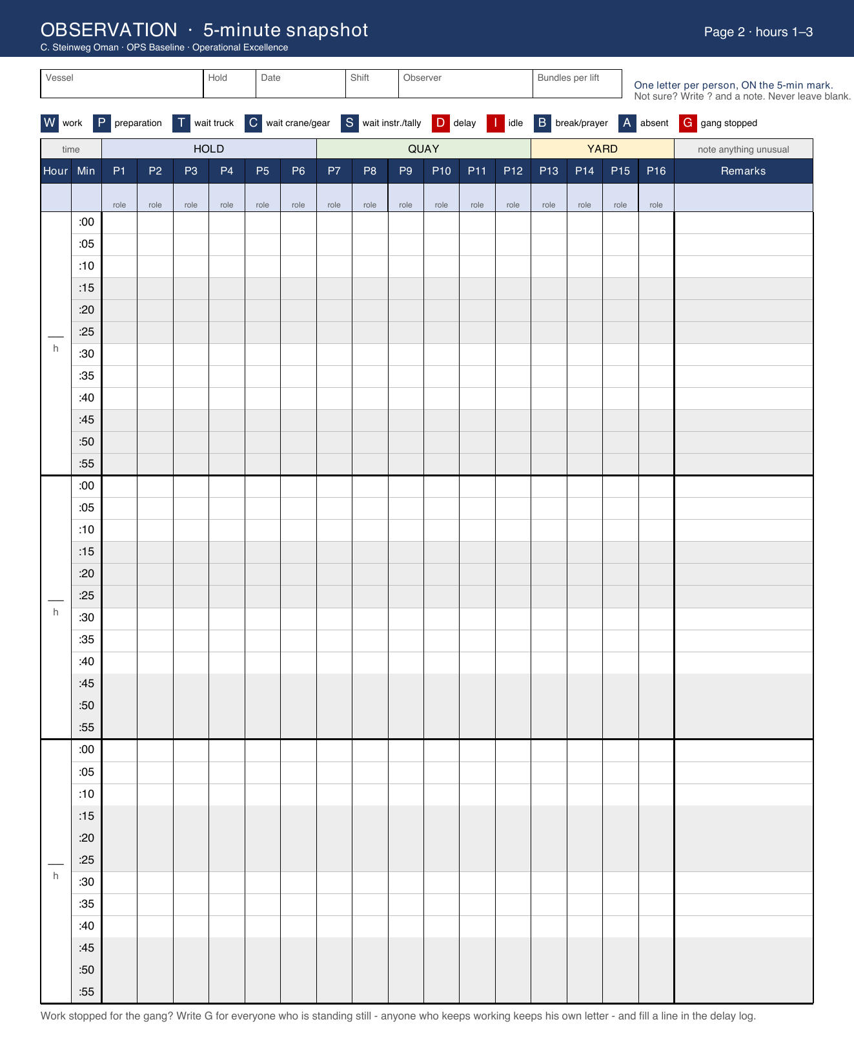
HOW IT IS RECORDED
Every five minutes, written down
One letter per position, on the five-minute mark. Up to sixteen positions in the gang — hold, quay and yard.
Vessel, hold, berth, shift, date and observer on every page.
Every stop longer than five minutes gets its own line: start, end, cause, and whether the gang stopped.
No names. We measure the process, not the person.
CSO · OPERATIONS · PMO | OPS-PRES-SST-01 · REV 5.0
8 / 9

Slide 9
WHAT WE MEASURE
Five minutes, one reason
Threshold
More than 5 minutes from the operational start or stop. No further tolerance.
Recorded
The actual time and one reason code. No names, no blame.
Reported
On-time start %, on-time finish %, lost crane hours — controllable and not.
Reviewed
First data review with Operations after about one month.
Weeks 1 to 3 we settle in. From week 4 the procedure simply applies.
CSO · OPERATIONS · PMO | OPS-PRES-SST-01 · REV 5.0
9 / 9

